Slide 1

An application that allows users to expand their French vocabulary* in a virtual reality environment
Computer Programming for Engineers ENGR-UH 1000
Khalid Dfa Alla (kd2806)
Riad Nassri (rn2362)
Hassan Zou'bi (haz5906)

Slide 2
INTRODUCTION
Have you ever wondered what the most effective way to learn a language is?
It is often said that the best way to learn a language is to immerse yourself in it.
Lingua aids users in language acquisition by providing an alternative to living in a country to learn its language.
It enhances users' willingness to learn and engages them in a VR atmosphere where it is crucial to repeatedly communicate through an unfamiliar language.
This way, learning languages is made easy, and FUN!

Slide 3
MOTIVATIONS/SCOPE
To immerse users in language learning
Open gateways to other cultures
01
02
Affordable and effective tool
Lessons & practice in one
03
04
•The VR environment considers cultural details.
•Educates users on cultures, something not picked up in traditional methods.
•Culturally rich environments helps users achieve proficiency with more ease.
•Learning a new language requires sustained and consistent practice.
•As opposed to draining memorization, Lingua utilizes interactive methods, visuals, and repetition to immerse users.
•It is very reliable to learn a language in a country where it is spoken.
•Not everyone can afford/ is able to travel.
•Lingua is the best alternative; anywhere, anytime.
•Provides video lessons.
•Masters communication, comprehension, and reading simultaneously.

Slide 4

VIDEO DEMONSTRATION

Slide 5
LESSONS & TAKEAWAYS
UNITY
→ Creating scenes and user interface.
→ How to implement voice recognition.
→ How to manipulate assets in Unity and navigate the platform
→ Importance of different features & how they function (box colliders, mesh colliders).
C# LANGUAGE
→ Syntax for C# coding.
→ How to implement C# in unity.

Slide 6
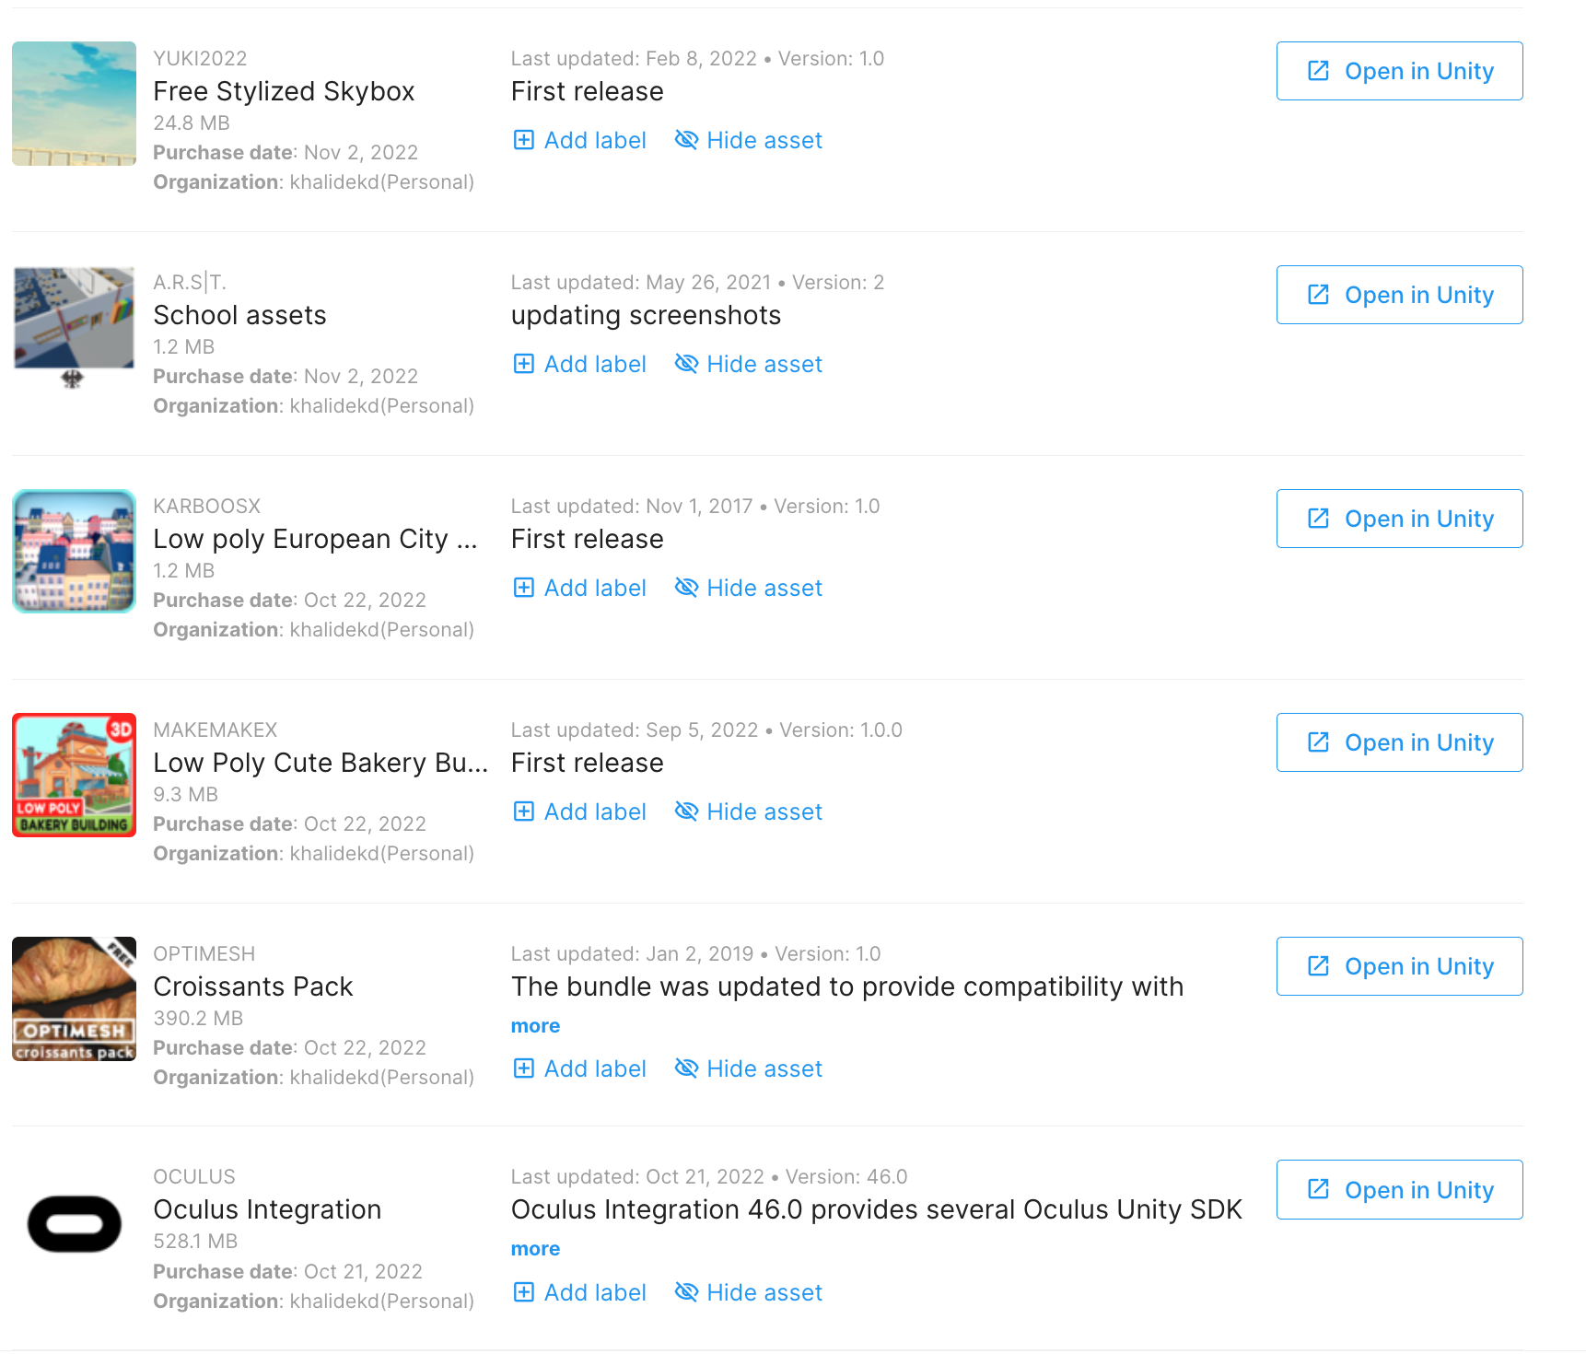
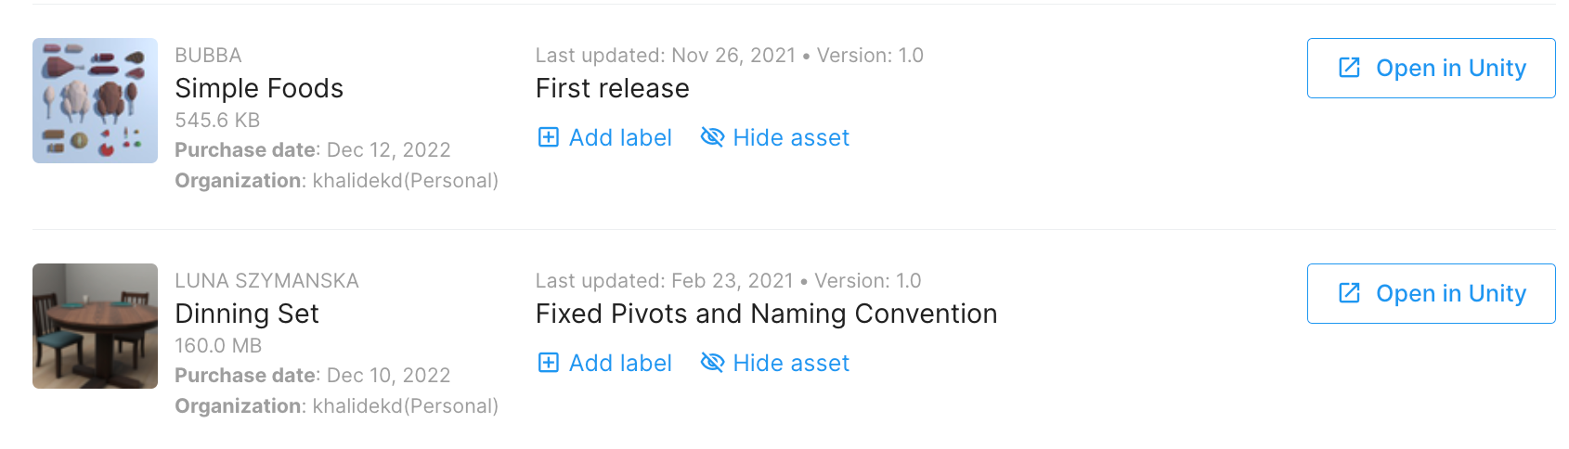
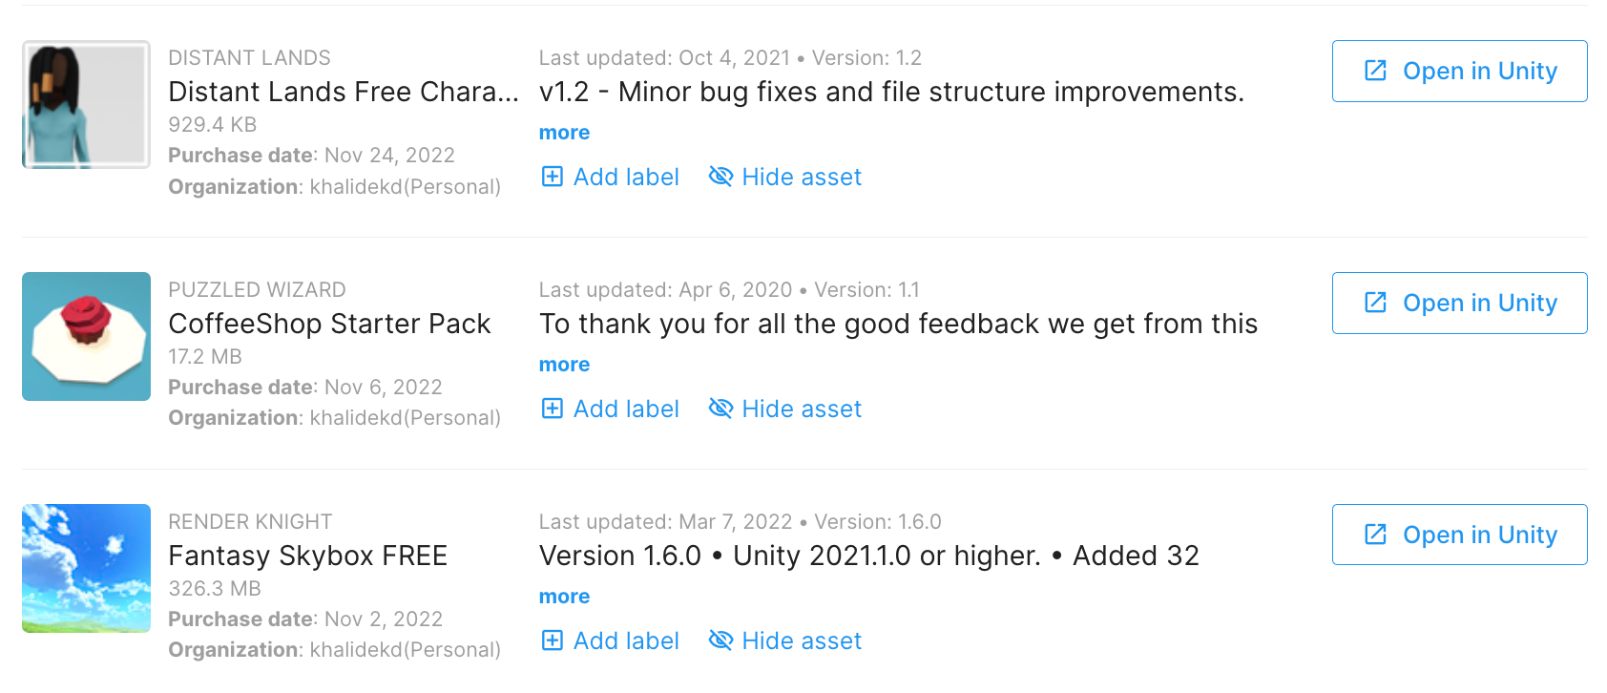
ASSETS USED

Slide 7
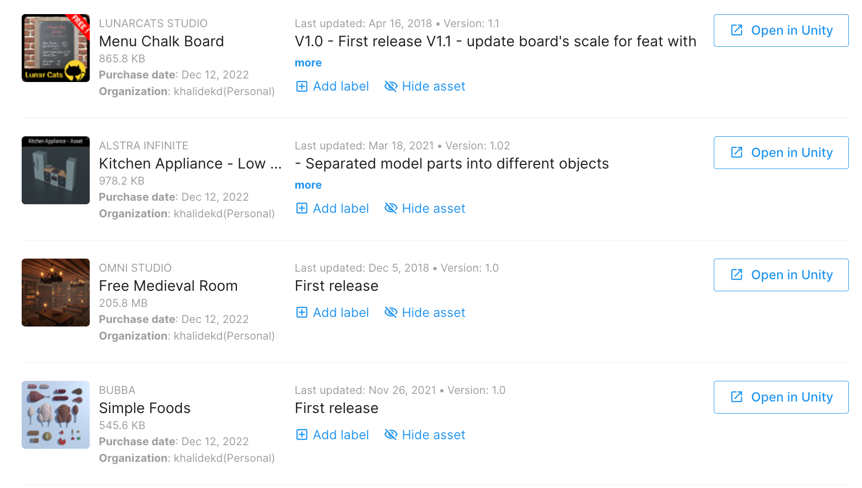
ASSETS USED

Slide 8
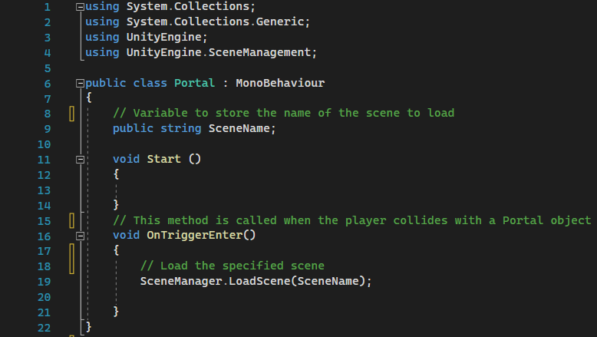
CODE
PORTAL
Notes:
This code defines a Portal class which is a MonoBehaviour in the Unity game engine. The Portal class has a SceneName string variable which stores the name of the scene that should be loaded when the player collides with a Portal object. In the Start method, no action is taken. In the OnTriggerEnter method, the SceneManager is used to load the scene specified by the SceneName variable.
It appears that this code is intended to be attached to a game object in Unity to create a portal that the player can walk through to change scenes. When the player collides with the object, the OnTriggerEnter method is called and the specified scene is loaded.
Overall, this code is a basic implementation of a scene-changing portal in Unity. It could be improved by adding additional functionality such as animations or effects when the player enters the portal, or by implementing error-handling to ensure that the specified scene exists and can be loaded.

Slide 9
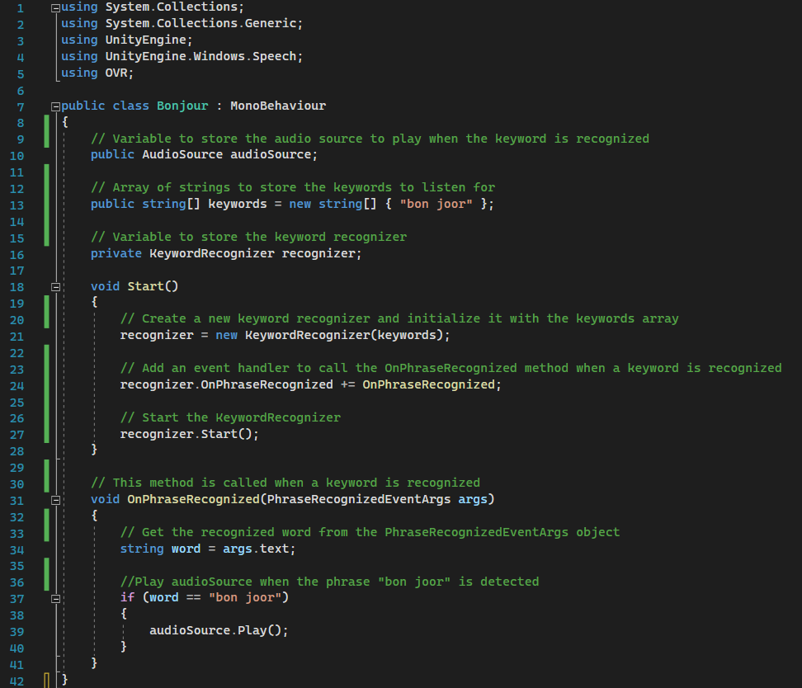
CODE
VOICE TRIGGERED AUDIO

Slide 10
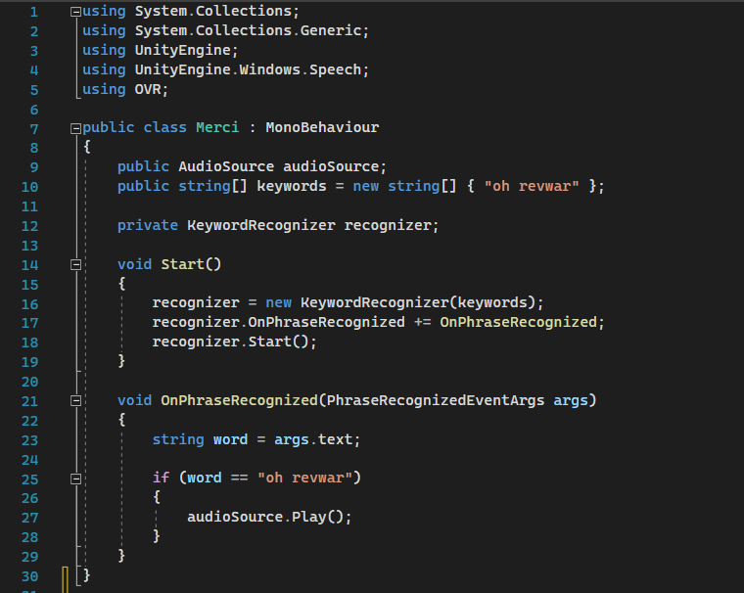
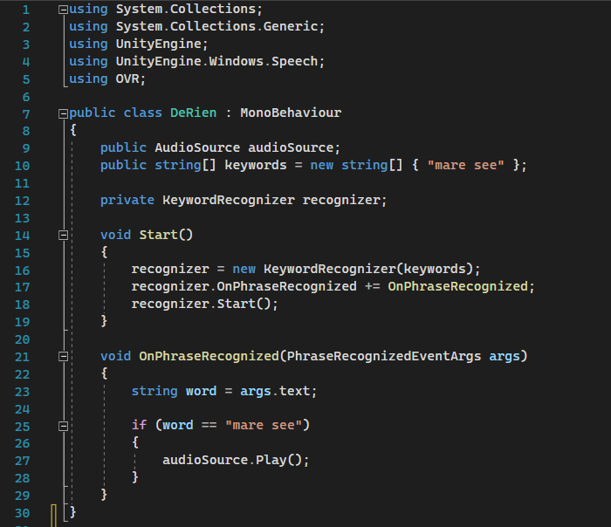
CODE
VOICE TRIGGERED AUDIO

Slide 11
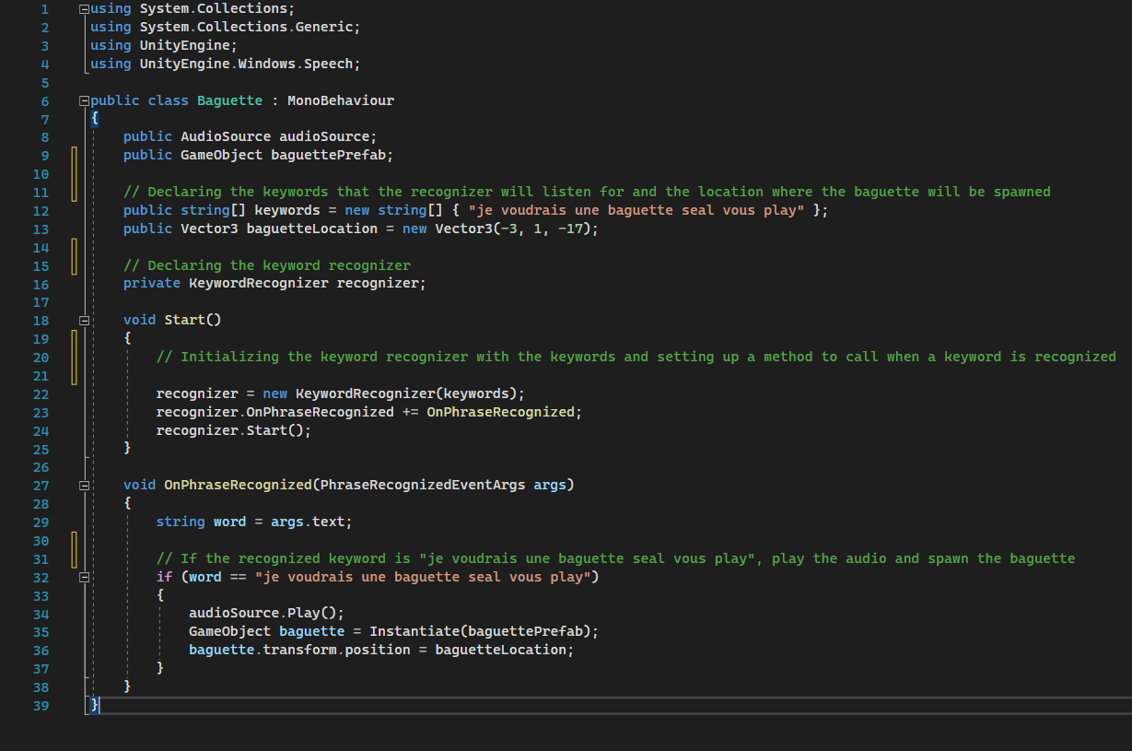
CODE
VOICE TRIGGERED AUDIO AND OBJECT MANIPULATION
Notes:
This part of the code defines a Baguette class which is a MonoBehaviour in the Unity game engine. The baguette class has a audioSource AudioSource variable and a baguettePrefab GameObject variable.

Slide 12
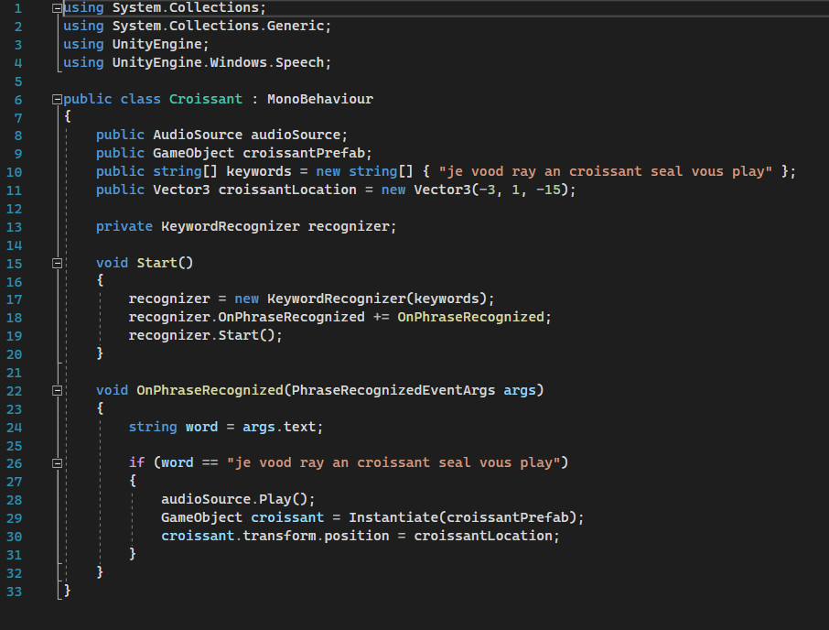
CODE
VOICE TRIGGERED AUDIO AND OBJECT MANIPULATION

Slide 13
CHALLENGES FACED
Navigating Unity (Understanding the platform and how to use it).
Learning how to code using C#
Connecting the Oculus Quest VR headset to Unity
Voice commands; The voice command was not recognizing french so similar English words had to be used. (I.e. “seal vous play” for “s'il vous plait” or “oh revwar” for “au revoir”)
Faced an issue where all assets were pink (due to shaders mismatch)
Falling through the ground problem (Floor needed a collider)
Initially, portal was not working properly due to the box mesh being too small.

Slide 14
LIMITATIONS
The voice recognition is not one hundred percent accurate due to the default setting being in English
We were limited only to the free assets in the Unity Asset Store so not all the visual goals/expectations were met
The main menu environment was not fully created/focused on and could be improved to expand the possible scenarios
French culture was not entirely depicted

Slide 15
Future Developments
Add more scenes and longer dialogues.
Make the environment more natural (i.e. adding people that the user can communicate with on the street, add error dialogues for wrong voice inputs, etc.)
Add subtitles during the dialogue to make verbal comprehension easier and strengthen reading comprehension.
Implement other languages in Lingua.
Create a reward system to motivate users to play the game

Slide 16
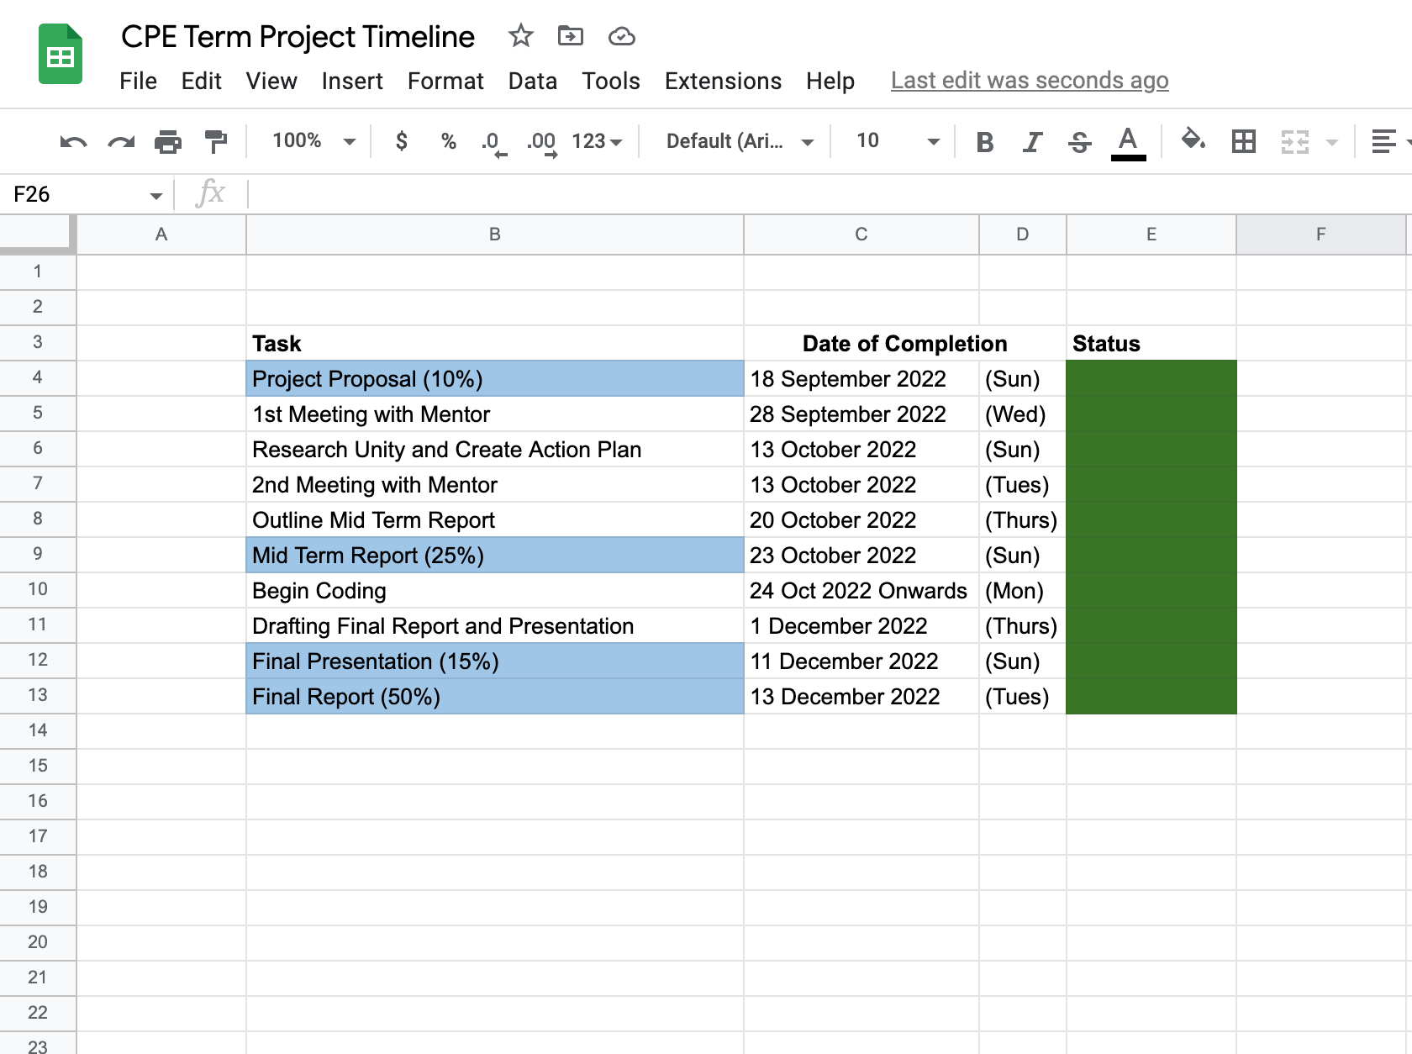
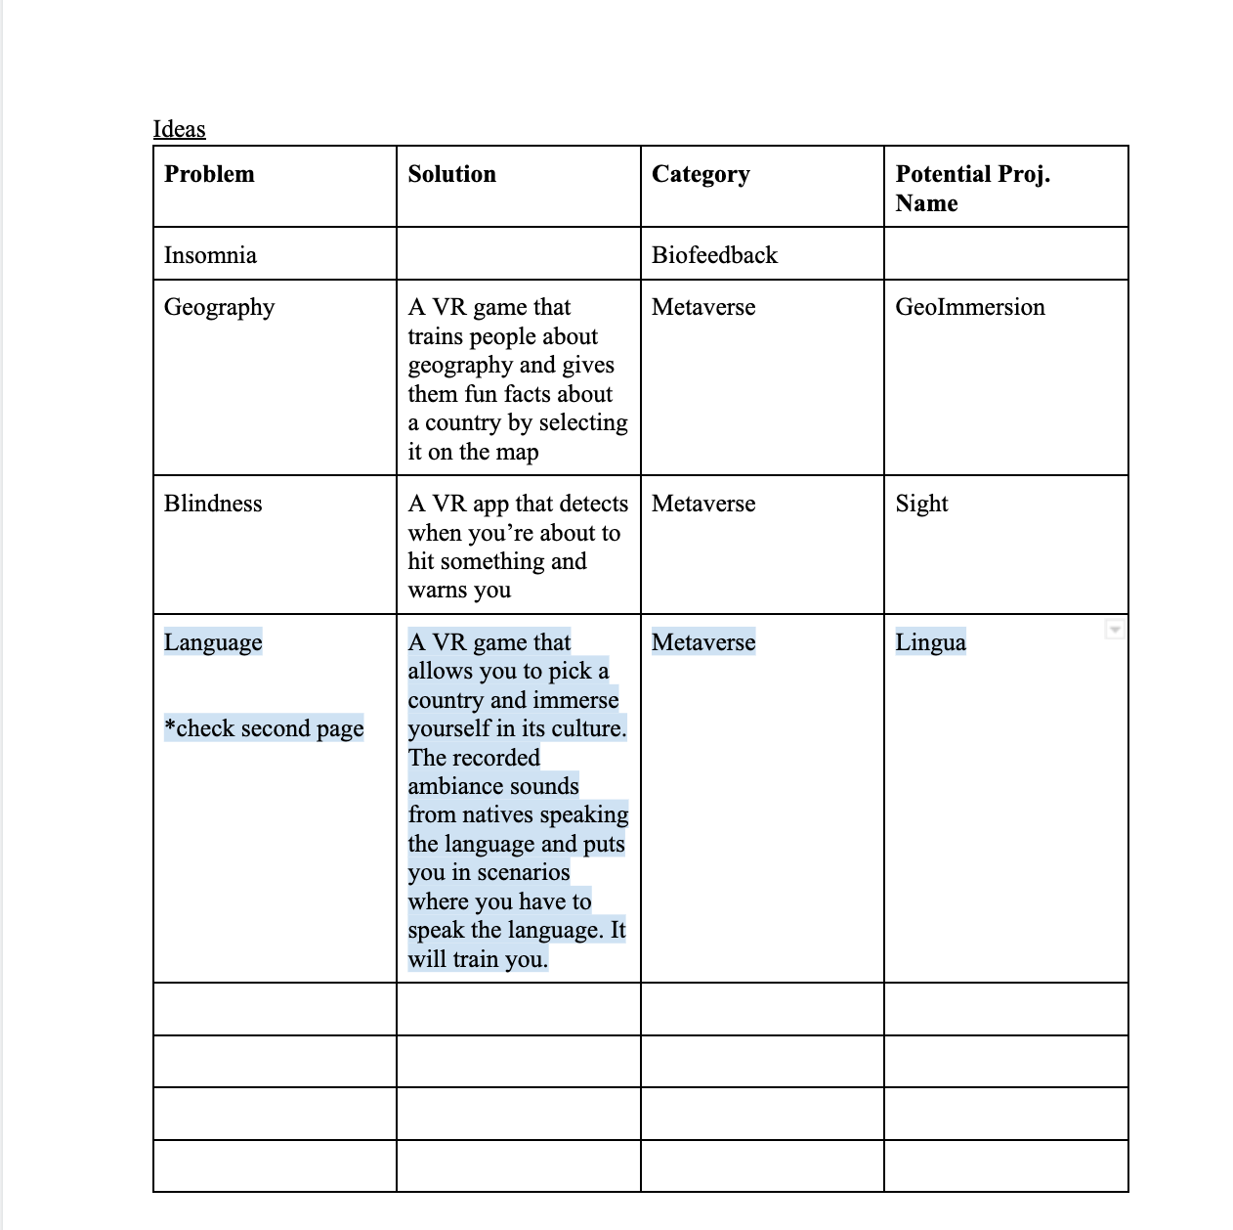
HOW IT WAS DONE

Slide 17
THANK YOU!
AU REVOIR!

Slide 18
REFERENCES
Christina. “Learning about Culture Is Essential to Learning a Language.” Clear Words Translations, Clear Words Translations, 21 Nov. 2017, http://clearwordstranslations.com/learning-a-language/#:~:text=Culture%20is%20essential%20when%20studying,staring%20at%20people%20in%20books.
“How to Order at a French Bakery like a Local | Super Easy French 67.” YouTube, YouTube, 18 Jan. 2020, https://www.youtube.com/watch?v=-4p0fngSbUs&ab_channel=EasyFrench.
“Low Poly European City Pack: 3D Urban.” Unity Asset Store, https://assetstore.unity.com/packages/3d/environments/urban/low-poly-european-city-pack-71042. Accessed October 19, 2022.
Migratingmiss. “Can You Really Learn a Language by Moving Abroad?” Migrating Miss, 23 Oct. 2017, www.migratingmiss.com/can-really-learn-language-moving-abroad/. Accessed October 15, 2022.
“Switching Scene on Trigger Unity (Code in DESC If Anyone Wants It).” YouTube, YouTube, 11 June 2020, https://www.youtube.com/watch?v=xbWr8f_LHGY.
“How to Change Scenes in Unity Using C# (Unity Tutorial 2021).” YouTube, YouTube, 14 May 2021, https://www.youtube.com/watch?v=gtpXc_9MR6g.
“How to Add Voice Recognition to Your Game - Unity Tutorial.” YouTube, YouTube, 27 Sept. 2018, https://www.youtube.com/watch?v=29vyEOgsW8s.
“Fix the Pink in Unity | 2022.” YouTube, YouTube, 18 Mar. 2022, https://www.youtube.com/watch?v=_R-2PNNjXAI.
“Learn Game Development w/ Unity: Courses & Tutorials in Game Design, VR, AR, & Real-Time 3D.” Unity Learn, https://learn.unity.com/.

